Slide 1
Robotic Arm Project
Robotics Club @ UCSB

Slide 2
Project Goals
Build an electronically controlled robotic arm with dimensions and capabilities similar to a human arm
The arm should include a hand or claw for interacting with objects
Make it simple to program for specific tasks and easy to integrate with other projects in the future

Slide 3
Subsystems
Frame
Actuators
Power electronics
Control electronics
Firmware
Application software

Slide 4
Feasibility Analysis
The actuators will likely be the main cost driver in the system
The available actuators will determine the scale that will be feasible for the project
A mathematical model of an arm was created and used to find the forces and torques that the actuators would have to sustain to perform various actions
Being able to lift a 250g object while in any position was chosen as a design goal

Slide 5
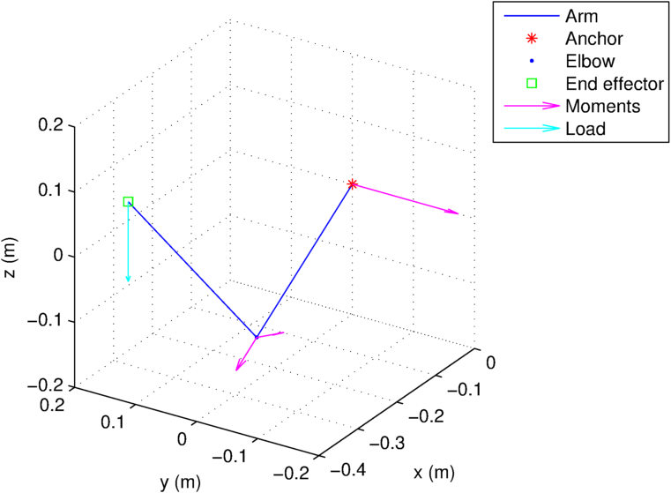
Arm model showing required torque at each joint

Slide 6
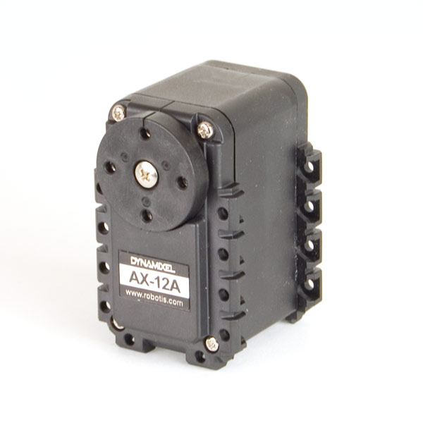
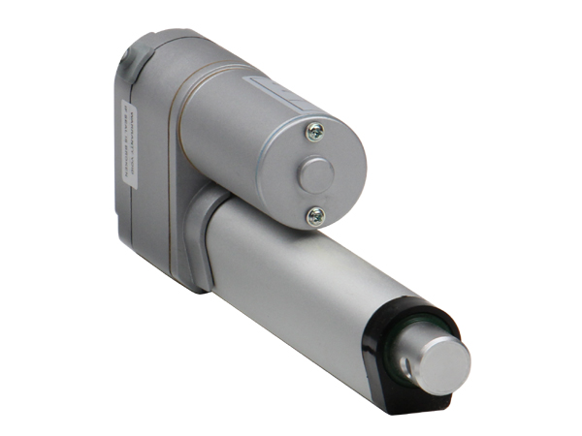
Actuator Selection
With the required performance for each joint determined, we searched for suitable actuators distributed by familiar suppliers
We found a combination of linear actuators with potentiometer feedback and rotary servomotors with integrated feedback control that will fulfill the project requirements

Slide 7
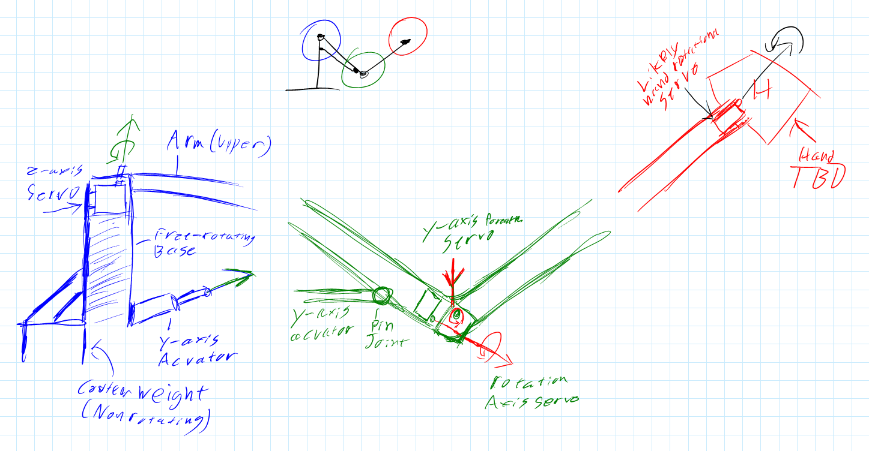
Design Sketches

Slide 8
Frame
Lightweight components desired for the upper arm to increase effective lift capacity
Material options: 3D printed plastic, laser cut plastic, machined aluminum, carbon fiber tubes
Base should be relatively heavy to counterbalance the arm when fully extended
May include springs or counterweights to take some of the static load off of the actuators

Slide 9
Power Electronics
The actuators that we looked at all run off of a 12V supply voltage
Several options:
A commodity PC power supply unit
Custom built 12V wall supply
11.1V 3-cell LiPo batteries for portability
Control electronics will be powered with regulated supplies derived from the main supply

Slide 10
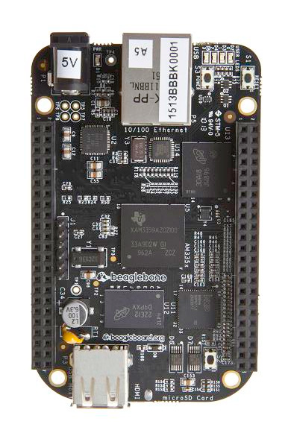
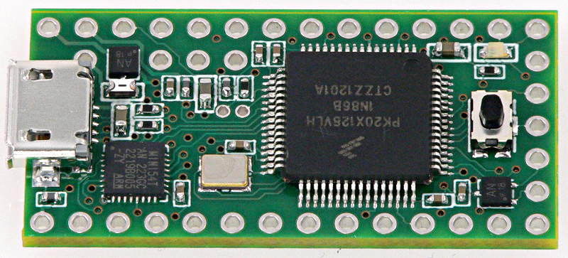
Control Electronics
A 32-bit microcontroller will talk directly to the sensors and actuators and perform latency sensitive tasks
A single-board computer using ROS takes care of higher level tasks, giving actuator commands to and getting feedback data from the microcontroller

Slide 11
Software
Both the microcontroller firmware and ROS software will be written in C++
Intent is to have basic functionality that is unlikely to change in the firmware, and application-specific software running on the single-board computer
Many possibilities available with this architecture
Complex trajectory calculations
Integration with OpenCV for computer vision
Control of the arm over a network

Slide 12
Cost Estimate
Actuators: $400
Frame: ≤$400
Power electronics: $100
Control electronics: <$100
The frame is the subsystem with the largest uncertainty
Cost is very dependent upon the scale
The current estimate assumes a 1:1 scale with respect to a human arm

Slide 13
The Team
Current core team:
Patrick Clary, 3rd year Mechanical Engineering
Tirion Wray, 2nd year Mechanical Engineering
Carl Felton, 4th year Electrical Engineering
The club uses a fluid team structure, so most of our members will have worked on this project at some point or another

Slide 14
Time Table
Fall quarter will largely be devoted to design
The beginning of Winter quarter should see us begin to order parts and start construction
Firmware will be written as components are added
The mechanics should be finished by sometime in Spring quarter
Application software will be written starting when the firmware interface starts to stabilize

Slide 15
What’s Next
Design the frame of the arm and select which materials to use
Create a CAD model of the arm and confirm that the design meets the requirements
Brainstorm ideas for the hand/claw and develop a design for it
Design and prototype the electronic components
Investigate ideas for the interface between the firmware and the application software

